Slide 1

DEEP NEURAL NETWORK MODULE # 3 : LINEAR NEURAL NETWORKS FOR REGRESSION
Neha Vinayak
DNN Team
BITS Pilani WILP

Slide 2
The instructor is gratefully acknowledging the authors who made their course materials freely available online.
This deck is prepared by Seetha Parameswaran.
Deep Learning

Slide 3








Table of Contents
Regression
Linear Regression
The Linear Model: Single Neuron
Worked Example
Evaluation
Python Implementation Implementation Tips
Summary
1
2
3
4
5
6
7
8
Deep Learning

Slide 4
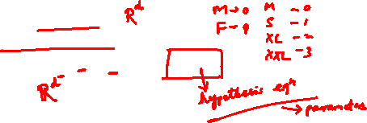
What is Regression?
Definition
Regression is a supervised learning task that predicts a continuous-valued output based on input features.
Key Characteristics:
Input: Feature vector x ∈ R^{d}
Output: Real-valued target y ∈ R
Goal: Learn a function f : R^{d} → R such that y ≈ f (x)
Deep Learning

Slide 5
Examples of Regression Problems
House Price Prediction
Input: Size, location, number of rooms
Output: Price in dollars
Temperature Forecasting
Input: Historical weather data, season, humidity
Output: Temperature in degrees
Stock Price Prediction
Input: Historical prices, trading volume, market indicators
Output: Future stock price
1
2
3
Deep Learning

Slide 6


Table of Contents
Regression
Linear Regression
The Linear Model: Single Neuron
Worked Example
Evaluation
Python Implementation Implementation Tips
Summary
1
2
3
4
5
6
7
8
Deep Learning

Slide 7

What is Linear Regression?
Definition
Linear regression assumes the output is a linear combination of the input features.
Mathematical Form:
y = w₀ + w₁x₁ + w₂x₂ + · · · + w_{d}x_{d}
(1)
where:
x = [x₁, x₂, . . . , x_{d} ]^{T} are the input features
w = [w₁, w₂, . . . , w_{d} ]^{T} are the weights
w₀ is the bias term
Deep Learning

Slide 8
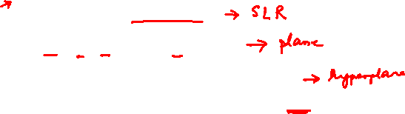
Examples of Linear Regression
1
Salary Prediction
Salary = w₀ + w₁ × Years of Experience
2
Crop Yield Prediction
Yield = w₀ + w₁ × Rainfall + w₂ × Fertilizer
3
Energy Consumption
Energy = w₀ + w₁ × Temperature + w₂ × Hour + w₃ × Day
The relationship between inputs and output is assumed to be linear.
Deep Learning

Slide 9
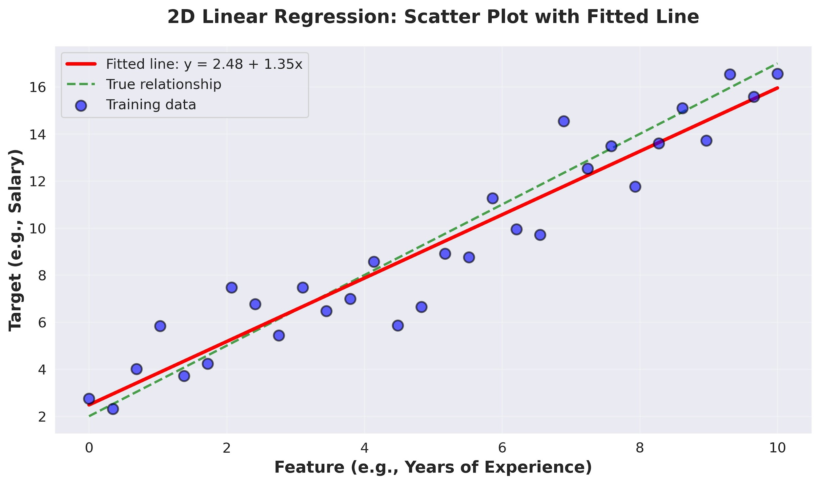
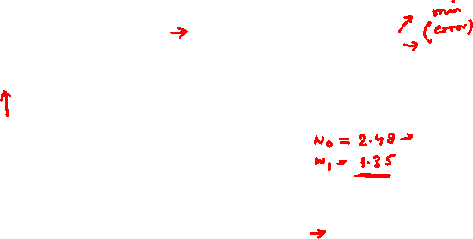
Visual Example: 2D Linear Regression
Deep Learning

Slide 10

Table of Contents
Regression
Linear Regression
The Linear Model: Single Neuron
Worked Example
Evaluation
Python Implementation Implementation Tips
Summary
1
2
3
4
5
6
7
8
Deep Learning

Slide 11
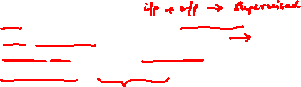
The Four Components
A complete machine learning system consists of:
1
Data: d -dimensional input vectors and target outputs Model: Single neuron implementing linear function Objective Function: Measures prediction error
Learning Algorithm: Gradient descent to optimize weights
2
3
4
Deep Learning

Slide 12
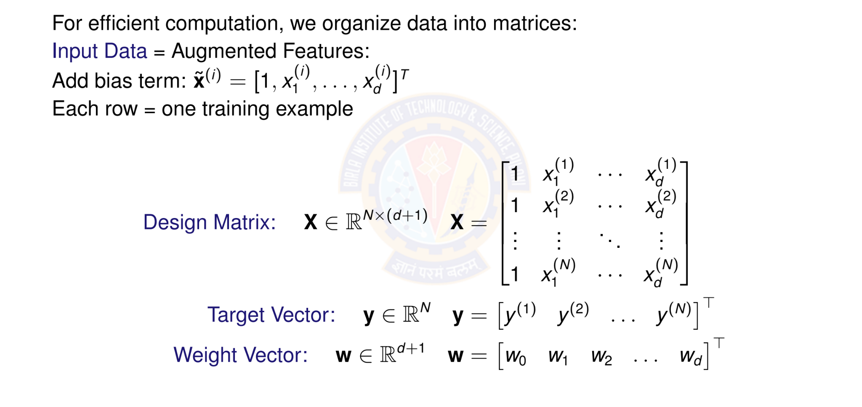
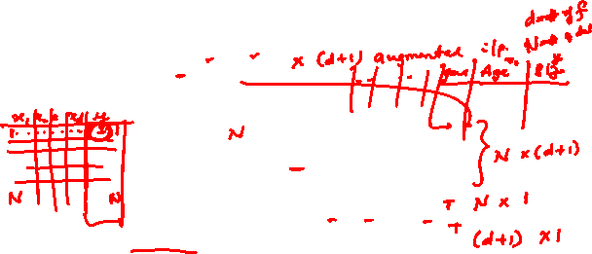
Matrix Form of Data
Deep Learning

Slide 13

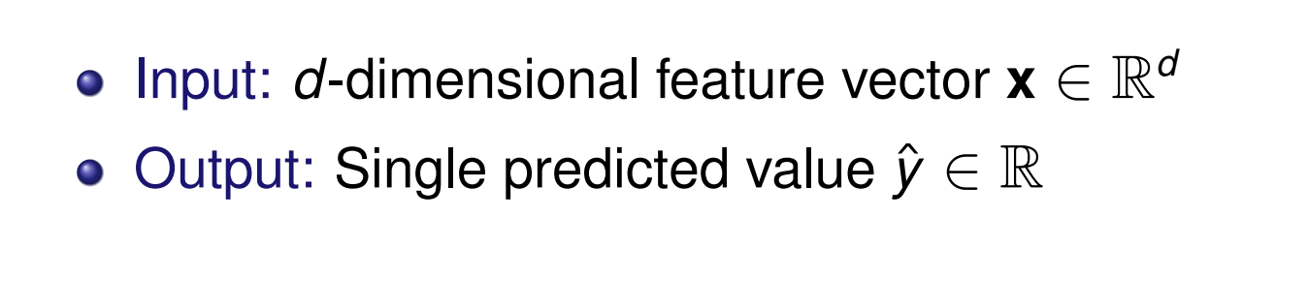
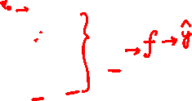
Linear Model as a Single Neuron
Model linear regression as a single artificial neuron:
1
x₁
w₀ w₁ w₂
f
Σ
y^{ˆ}
x
2
.
x_{d}
.
w_{d}
Deep Learning

Slide 14
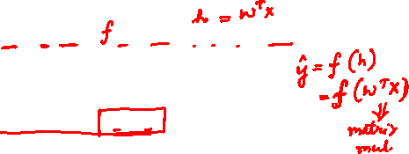
Linear Model Prediction
Model: A single neuron computes a weighted sum and applied identity activation function.
Prediction for input x:
y^{ˆ} = f (w^{T} x) = f (w₀ + w₁x₁ + w₂x₂ + · · · + w_{d} x_{d} )
(2)
where:
w = [w₀, w₁, . . . , w_{d} ]^{T} ∈ R^{d +1} are the model parameters
x = [1, x₁, . . . , x_{d} ]^{T} ∈ R^{d +1} is the input
f (·) is the identity activation f (z) = z
Vectorized form: for all predictions
y^{ˆ} = Xw
(3)
Deep Learning

Slide 15
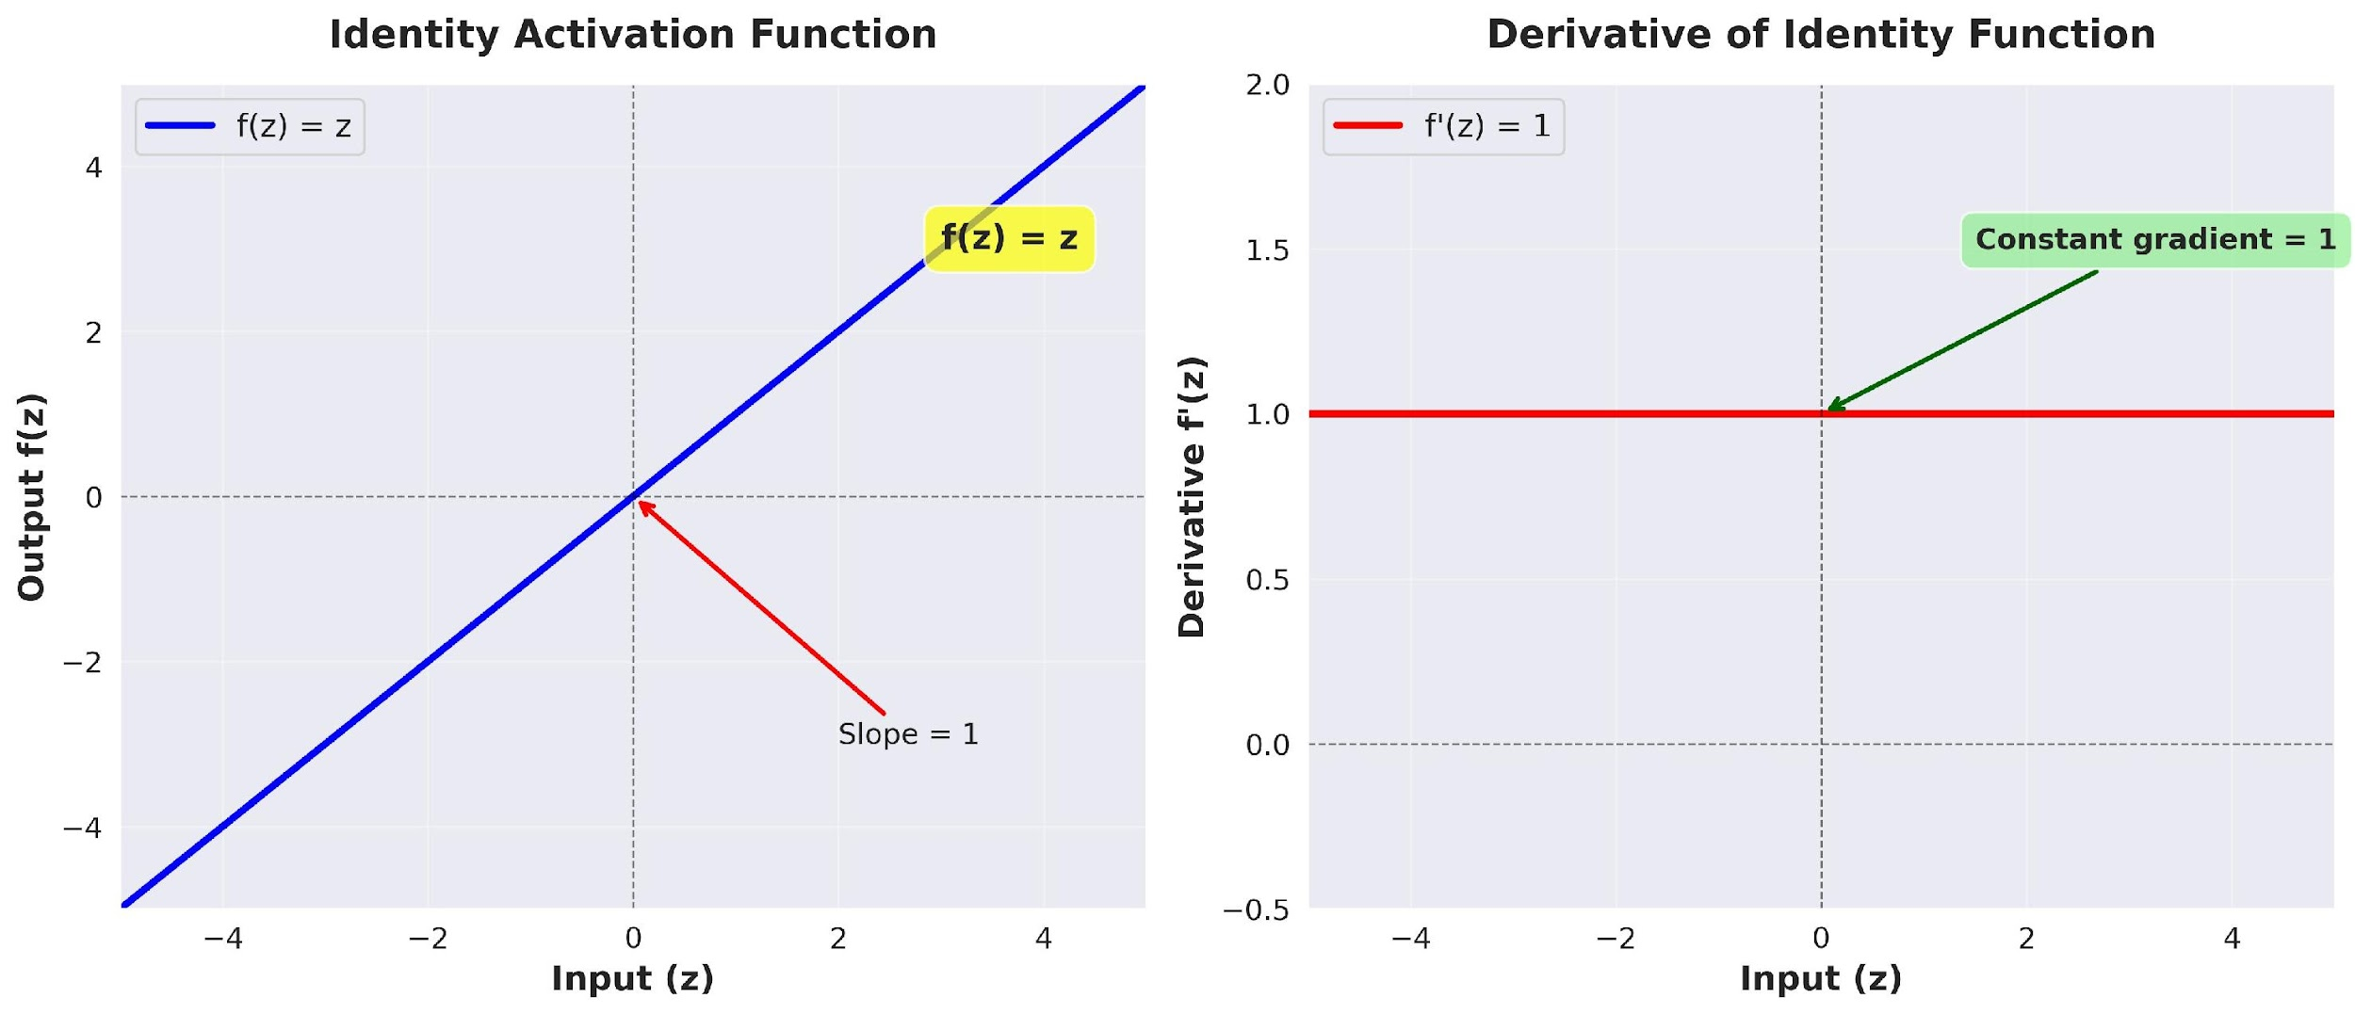
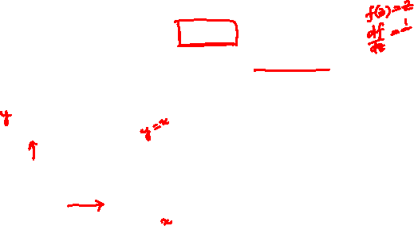
Identity Activation Function
Identity Activation Function
f (z) = z
(4)
Deep Learning

Slide 16
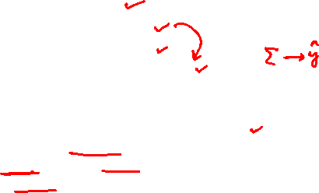
Identity Activation Function
Properties of Identity Function Output: Continuous, (−∞, ∞)
Differentiable everywhere: f '(z) = 1 Allows output to take any real value
Gradient flows unchanged through the neuron Perfect for predicting continuous targets
Why identity for regression?
Target values are continuous (prices, temperatures, etc.) Need to predict any real number, not just binary { 0,1 } Differentiability enables gradient-based optimization
No information loss from input to output
Deep Learning

Slide 17
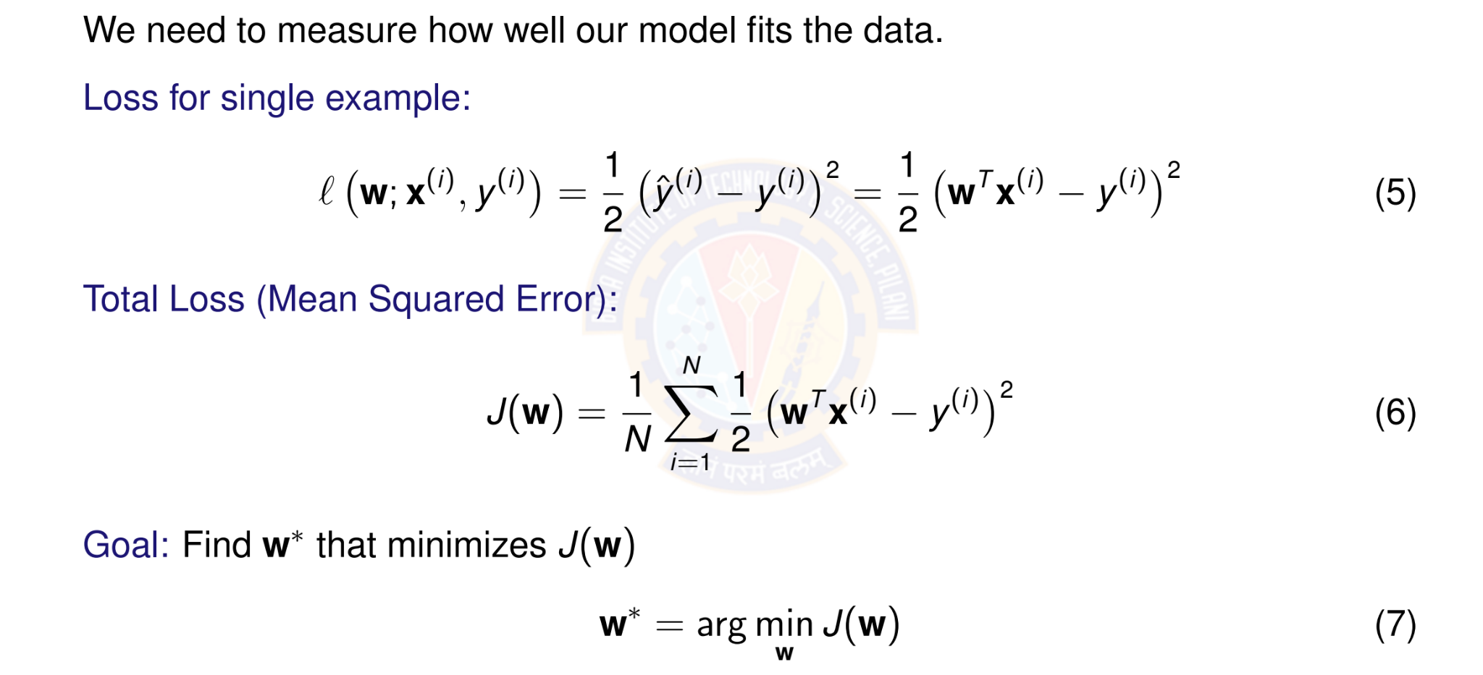
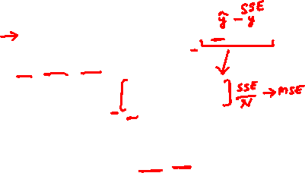
Objective Function: Squared Error Loss
Deep Learning

Slide 18
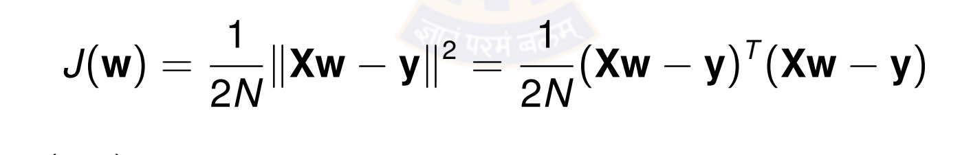
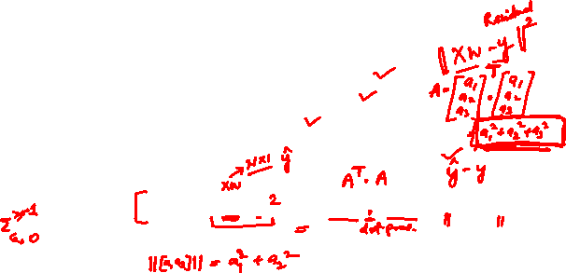
Why Squared Error?
Advantages of squared error loss:
Differentiable: Smooth everywhere, easy to optimize Convex: Single global minimum (for linear models) Penalizes large errors: Quadratic growth
Statistical interpretation: Maximum likelihood under Gaussian noise
Vector Form:
(8)
where X ∈ R^{N×(d +1)} is the design matrix and y ∈ R^{N} is the target vector.
Deep Learning

Slide 19
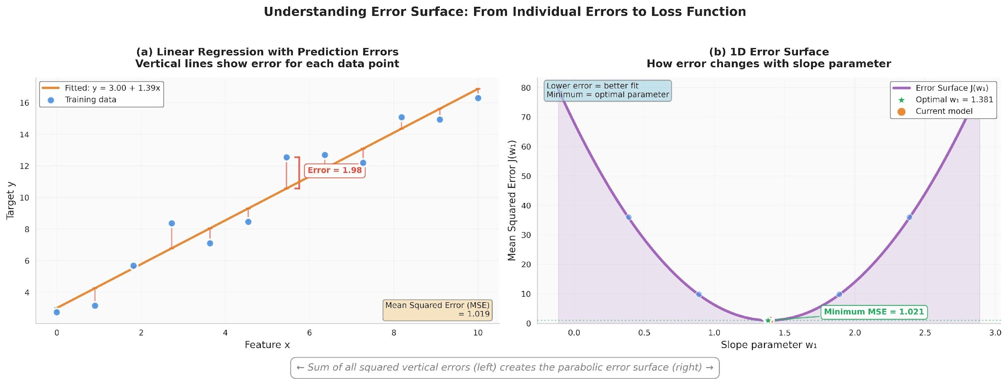
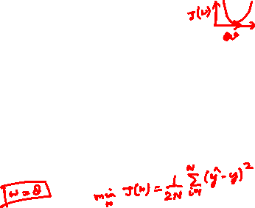
Visualizing the Error Surface
The error surface is convex with a single global minimum.
Deep Learning

Slide 20
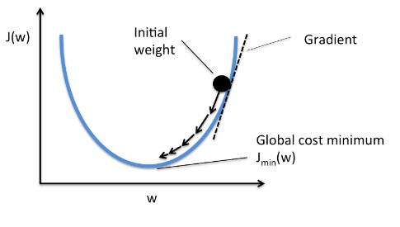
Gradient Descent Algorithm
Idea: Iteratively update weights in the direction of steepest descent
where η > 0 is the learning rate (step size).
Intuition: Move downhill on the error surface to find the minimum.
Deep Learning

Slide 21

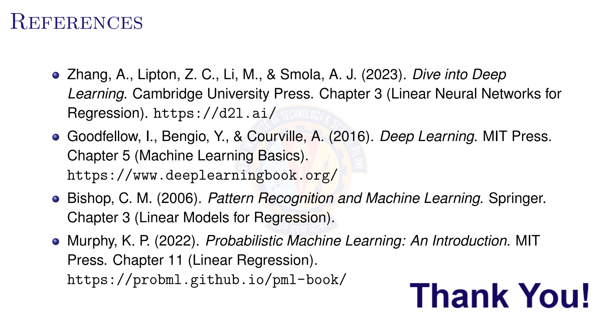
Deep Learning

